Slide 1
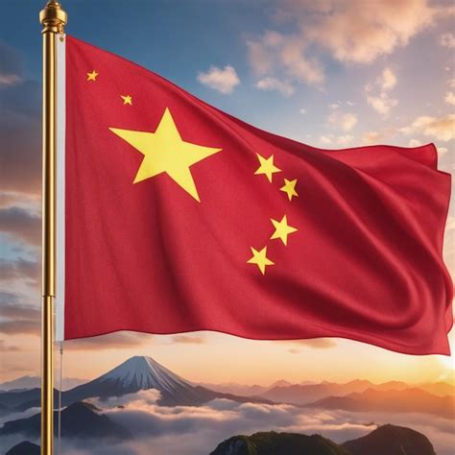
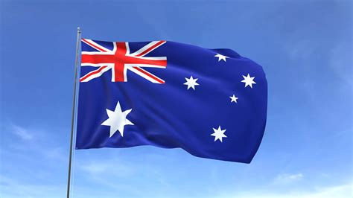
Single-culture country vs. Multicultural country
China vs. Australia
Speaker: Hudson Junior and Rhea

Slide 2
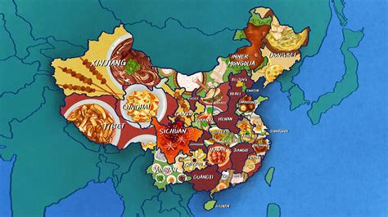
Chinese cuisine from various regions of China
“Grammar” and “dialects”

Slide 3
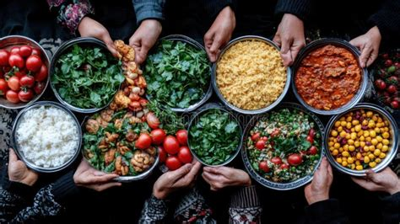
Diverse but unified

Slide 4
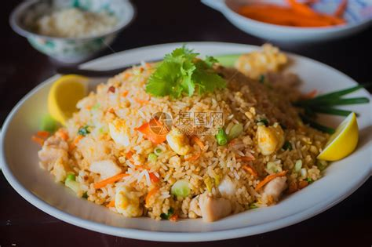
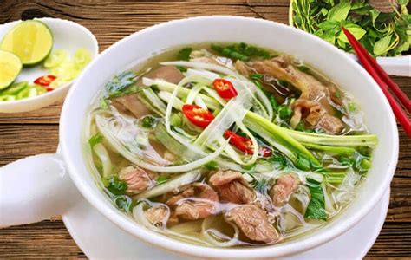
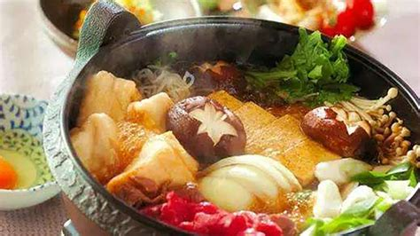
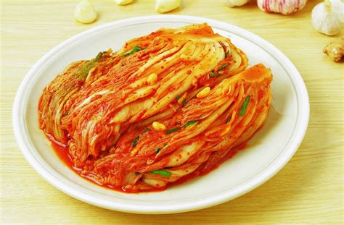
The influence of Chinese cuisine culture

Slide 5
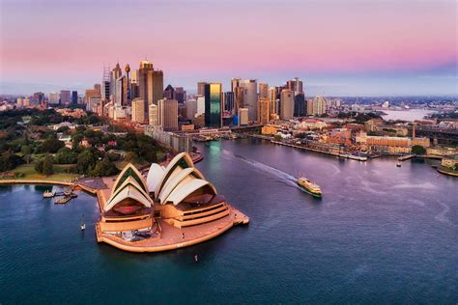

Australia, a Multi-ethnic and multi-cultural country
(Australian Government, Department of Home Affairs, 2017). (Australian Bureau of Statistics, 2025).

Slide 6
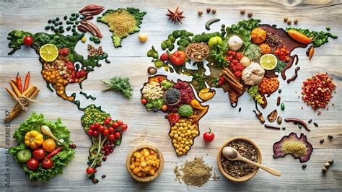
Diverse food cultures and localization
(Link, 2012)

Slide 7
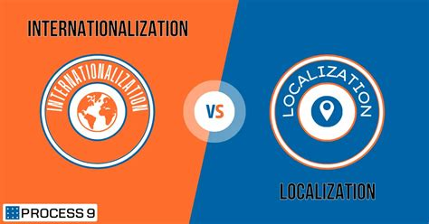
How to localize

Slide 8
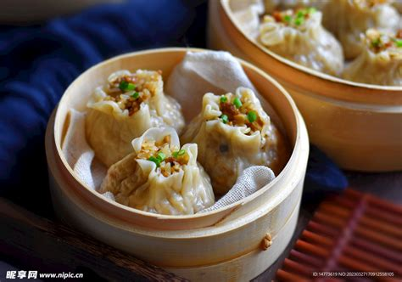
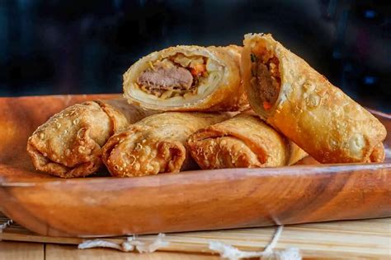
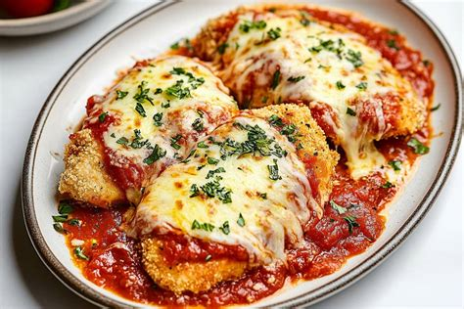
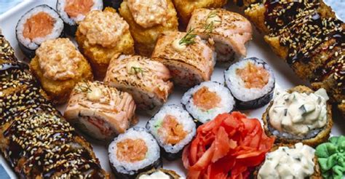
To facilitate your understanding, I have prepared four examples for you

Slide 9
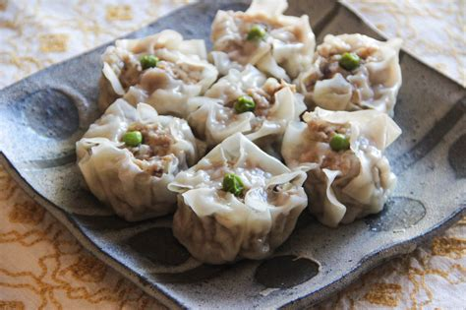
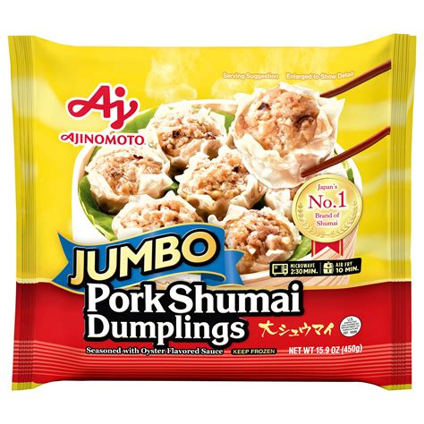
Localization: From manual production to automatic production
(Australian Broadcasting Corporation, 2016; City of Melbourne, 2025).

Slide 10
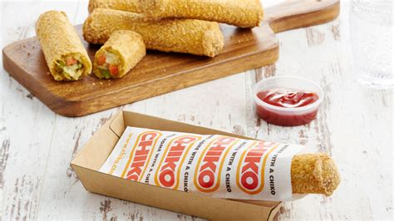
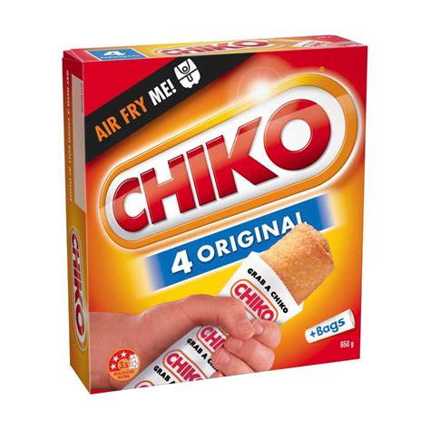
Localization: From freshly made food on the spot to frozen ready meals
(Museum of the Riverina, n.d.).

Slide 11
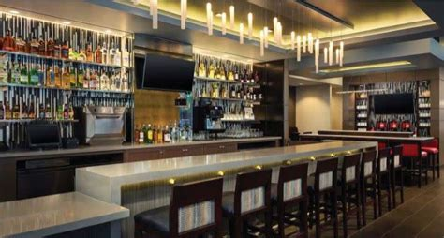
Localization: Bar culture
(Australian Broadcasting Corporation, 2019)

Slide 12
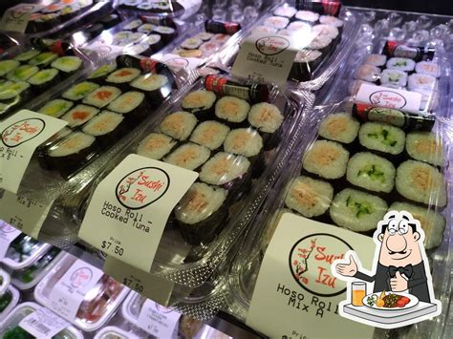
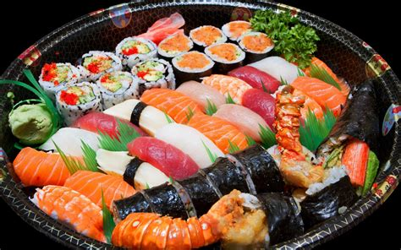
Localization: Grab-and-go
(McDonald, 2023; Australian Food Timeline, n.d.).

Slide 13
Conclusion

Slide 14
References
Australian Broadcasting Corporation. (2016, February 8). Dim sims: The history of a Chinese-Australian icon. ABC News. https://www.abc.net.au/news/2016-02-08/dim-sim-invention-a-story-of-chinese-australian-history/7148450
Australian Broadcasting Corporation. (2019, July 4). It's a pub staple across Australia, but how did the chicken parmigiana end up on the menu? ABC News. https://www.abc.net.au/news/2019-07-05/where-the-chicken-parmigiana-come-from/11277414
Australian Bureau of Statistics. (2025, April 30). Australia's population by country of birth, June 2024. Australian Bureau of Statistics. https://www.abs.gov.au/statistics/people/population/australias-population-country-birth/latest-release
Australian Food Timeline. (n.d.). 1993 Takeaway sushi. Retrieved March 3, 2026, from https://australianfoodtimeline.com.au/takeaway-sushi/
Australian Government, Department of Home Affairs. (2017). Multicultural Australia: United, Strong, Successful (Australia’s multicultural statement). https://www.homeaffairs.gov.au/mca/Statements/english-multicultural-statement.pdf
City of Melbourne. (2025). The Dirty Dozen: Stories behind the foods that made Melbourne (Exhibition catalogue). City Gallery, Melbourne Town Hall. https://citycollection.melbourne.vic.gov.au/wp-content/uploads/2025/07/CGal_DD_Catalogue_compressed.pdf

Slide 15
References
Link, C. A. (2012). Challenges to flavour: Influences on the cultural identity of cuisines in the Australian foodscape (Doctoral thesis, University of Western Sydney). https://researchers-admin.westernsydney.edu.au/ws/portalfiles/portal/94917592/uws_18117.pdf
Macquarie Dictionary. (2018, January 23). Word of the Year 2016. https://www.macquariedictionary.com.au/word-of-the-year/word-of-the-year-2016/
McDonald, E. (2023, November 17). Australian-style sushi is a thing and the internet is only just learning about it. delicious. https://www.delicious.com.au/food-files/article/australian-style-sushi-rolls-thing/9n4ttjrn
Museum of the Riverina. (n.d.). The Gold Chiko Roll. Retrieved March 3, 2026, from https://museumriverina.com.au/learn/collections/highlights/the-gold-chiko-roll
Northern Territory Government. (n.d.). Laksa. Retrieved March 3, 2026, from https://northernterritory.com/things-to-do/food-and-drink/laksa
Northern Territory Government. (n.d.). Amye (The Laksa Queen). Retrieved March 3, 2026, from https://northernterritory.com/articles/amye-the-laksa-queen
SBS Food. (2016, May 9). Unpacking the halal snack pack. https://www.sbs.com.au/food/article/unpacking-the-halal-snack-pack/stedyxkcy

Slide 16
References
[1] [2] [6] [8] [12] https://www.abc.net.au/news/2016-02-08/dim-sim-invention-a-story-of-chinese-australian-history/7148450
https://www.abc.net.au/news/2016-02-08/dim-sim-invention-a-story-of-chinese-australian-history/7148450
[3] [4] [9] https://www.homeaffairs.gov.au/mca/Statements/english-multicultural-statement.pdf
https://www.homeaffairs.gov.au/mca/Statements/english-multicultural-statement.pdf
[5] [17] [22] https://www.delicious.com.au/food-files/article/australian-style-sushi-rolls-thing/9n4ttjrn
https://www.delicious.com.au/food-files/article/australian-style-sushi-rolls-thing/9n4ttjrn
[7] [15] https://www.sbs.com.au/food/article/unpacking-the-halal-snack-pack/stedyxkcy
https://www.sbs.com.au/food/article/unpacking-the-halal-snack-pack/stedyxkcy

Slide 17
References
[10] [19] [21] https://www.abs.gov.au/statistics/people/population/australias-population-country-birth/latest-release
https://www.abs.gov.au/statistics/people/population/australias-population-country-birth/latest-release
[11] [23] https://researchers-admin.westernsydney.edu.au/ws/portalfiles/portal/94917592/uws_18117.pdf
https://researchers-admin.westernsydney.edu.au/ws/portalfiles/portal/94917592/uws_18117.pdf
[13] The Gold Chiko Roll: | Museum of the Riverina
https://museumriverina.com.au/learn/collections/highlights/the-gold-chiko-roll
[14] [20] https://www.abc.net.au/news/2019-07-05/where-the-chicken-parmigiana-come-from/11277414
https://www.abc.net.au/news/2019-07-05/where-the-chicken-parmigiana-come-from/11277414
[16] [18] https://northernterritory.com/things-to-do/food-and-drink/laksa
https://northernterritory.com/things-to-do/food-and-drink/laksa

Slide 18
Korean Cuisine vs
Multicultural Food in Sydney

Slide 19
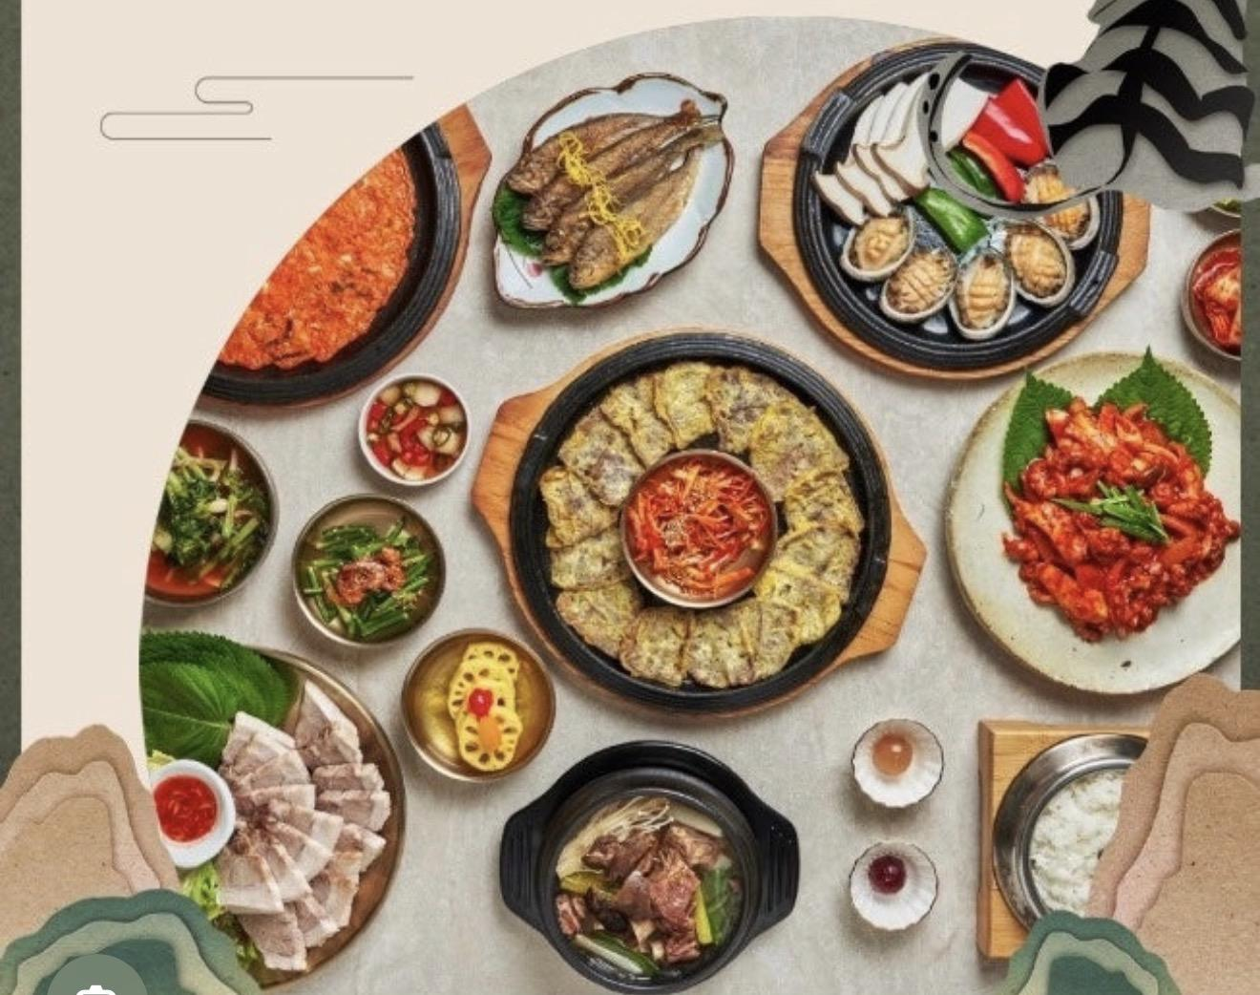
Introduction
• Korean cuisine
vs
Sydney food culture
• Personal experience
• Cultural comparison
1

Slide 20
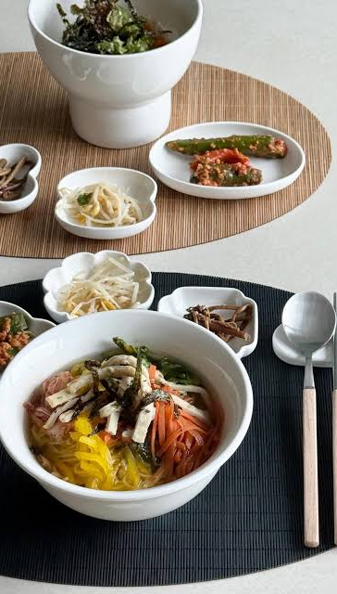
Korean Food Structure
• Rice + soup/stew + side dishes
• Banchan (shared)
• Clear structure

Slide 21
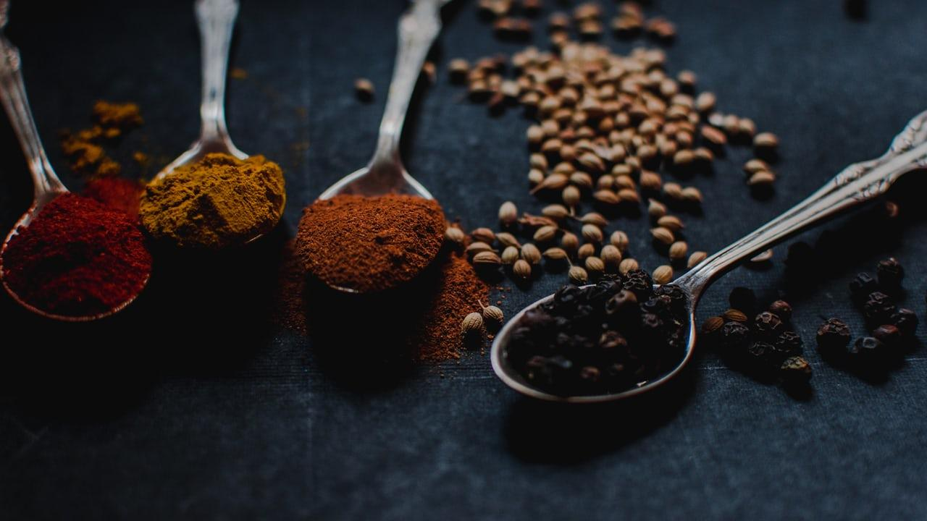
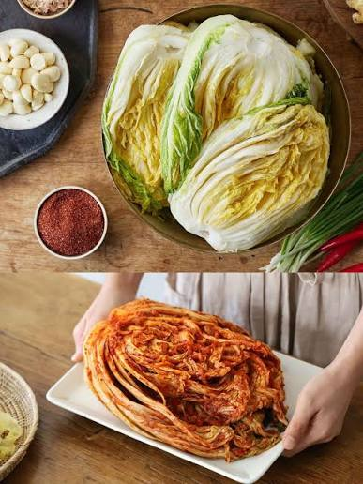
Kimchi
• Fermented foods
• Kimchi eaten daily
• Kimjang tradition

Slide 22
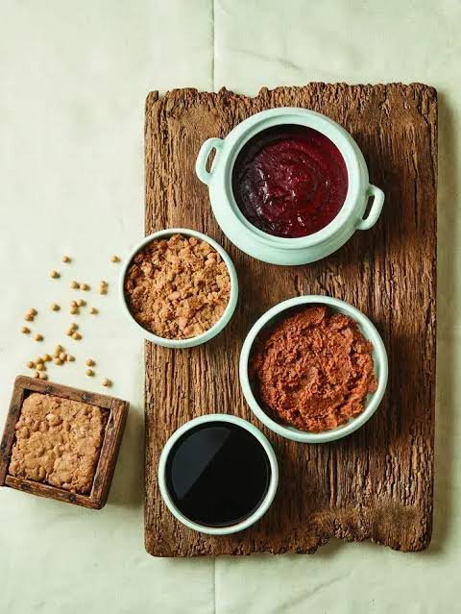
Jang
• Soy sauce
• Doenjang
• Gochujang
• Flavor base

Slide 23
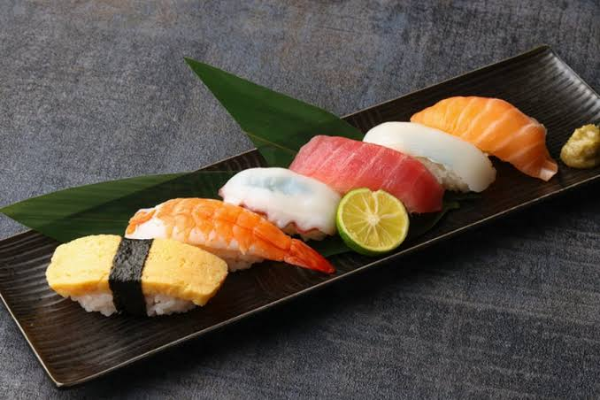
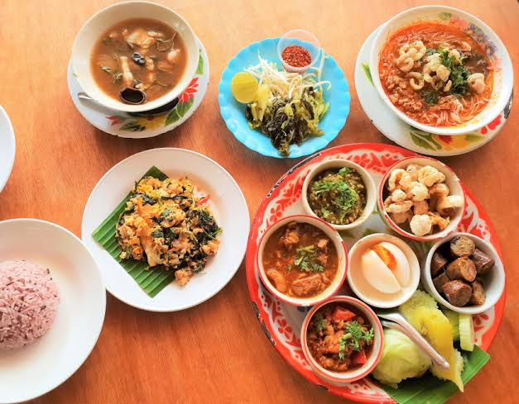
Multicultural Food in Sydney
• Many international cuisines
• Sushi & Thai food
• Different flavors
• Influence of migration

Slide 24
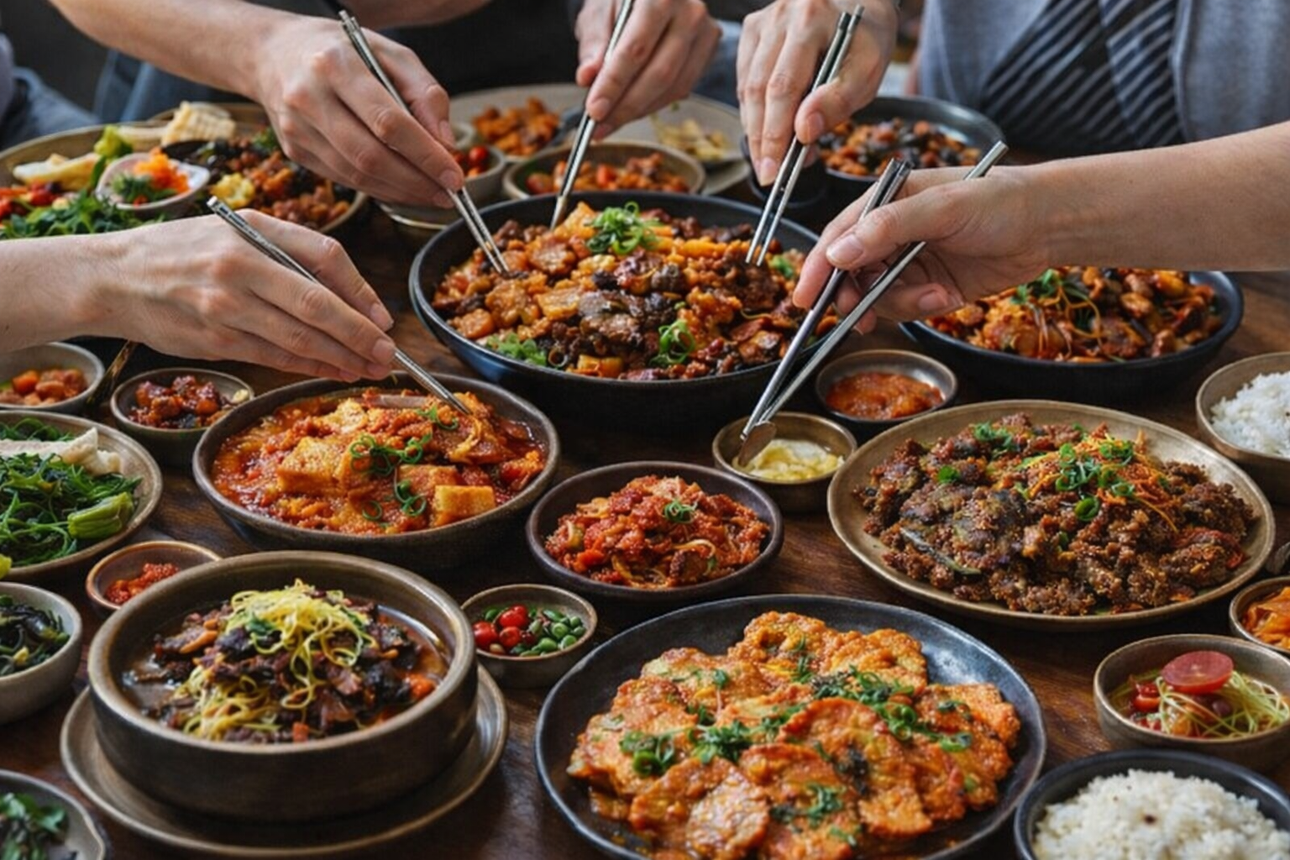
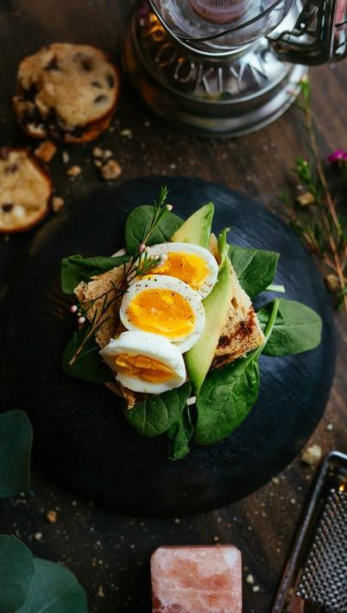
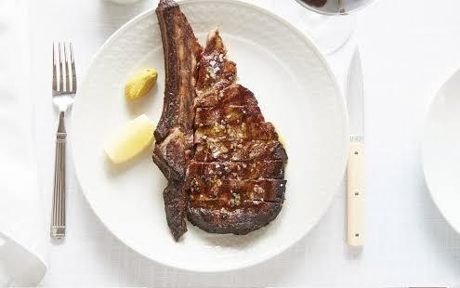
Serving Style Difference
Korea — Shared dishes
Sydney — Individual plates
Different eating styles
Black
Is the color of ebony and of outer space. It has been the symbolic color of elegance, solemnity and authority.

Slide 25
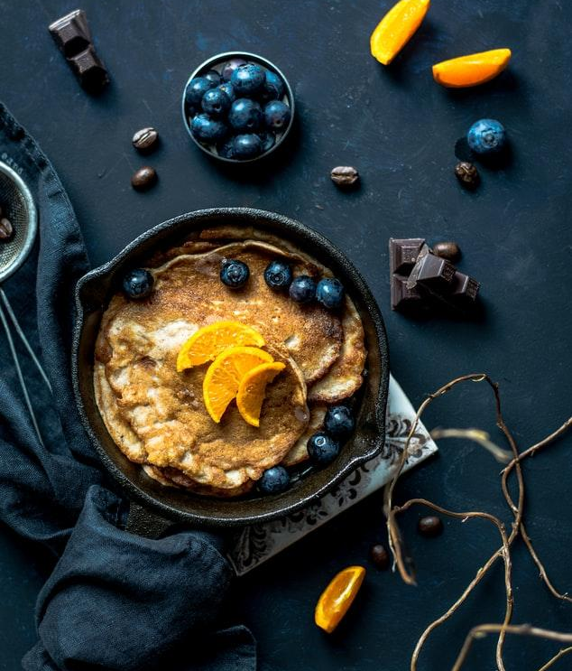
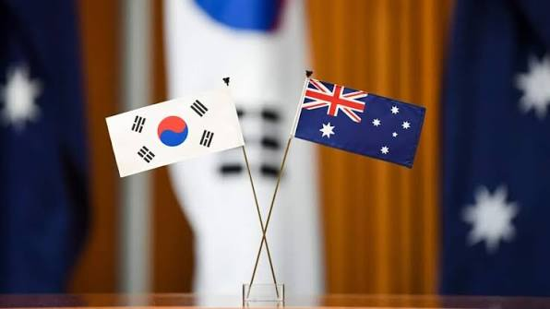
Similarities
• Food connects people
• Social experience in both cultures
• Helps people understand other traditions

Slide 26
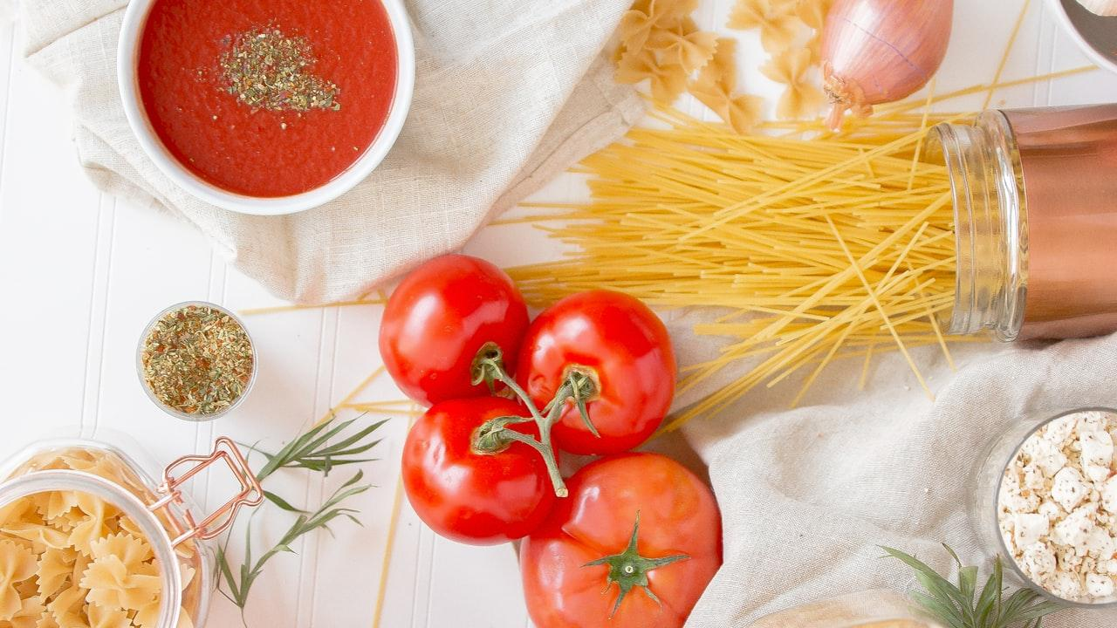
Conclusion
• Korean food → traditional & structured
• Sydney food → diverse & multicultural
• Food reflects culture and identity

